Slide 1

Year 6 SATs 2020 Presentation for Parents, Carers & Guardians

Slide 2
Welcome to the Year 6 team
Teachers, Learning support Assistants and Specialised Teachers
Name: Mr Chavhunduka and Miss Hirani
LSA’s: Mrs Das, Miss Samuels, Mrs Zylfo
Phase Leader: Mr Koorichh

Slide 3
Aims of this meeting
To inform you of the end of Key Stage 2 assessment procedures.
To give you a better understanding of what’s involved in the SATs tests and how we prepare our pupils.
To discuss how you can help your child prepare.
To answer any questions you may have.

Slide 4
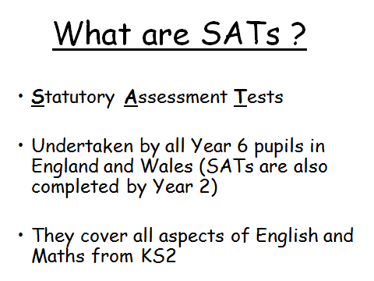

Slide 5
Why do the children do them?
Legally required.
To gain a national, local and individual picture of standards in education.
To check the progress being made by children.

Slide 6
When do they take place?
Children will sit the following SATs papers:
- Grammar, Punctuation and Spelling (Paper 1) – Monday 11th May 2020;
- Grammar, Punctuation and Spelling (Paper 2) – Monday 11th May 2020;
- Reading – Tuesday 12th May 2020;
- Maths Paper 1 (Arithmetic) – Wednesday 13th May 2020;
- Maths Paper 2 (Reasoning) – Wednesday 13th May 2020;
- Maths Paper 3 (Reasoning) – Thursday 14th May 2020.
Writing is assessed using evidence collected by your child’s teacher throughout Year 6, so there is no Year 6 SATs writing test.
There will be no Science sampling for Year 6 this year.
Therefore, no Year 6 Science SATs Paper in 2020.

Slide 7
When and how are the SATs carried out?
The tests will take place during normal school hours, under exam conditions;
Children are not allowed to talk to each other from the moment the assessments are handed out until they are collected after the test has ended;
Afterwards, the completed papers are sent away to be marked externally;
The children’s results are sent back to school at some point in July;

Slide 8
Timings
The standard timings of tests differ but last no more than 60 minutes:
- Grammar, Punctuation and Spelling (Paper 1) – 45 minutes;
- Grammar, Punctuation and Spelling (Paper 2) – 15 minutes;
- Reading – 60 minutes;
- Maths Paper 1 (Arithmetic) – 30 minutes;
- Maths Paper 2 (Reasoning) – 40 minutes;
- Maths Paper 3 (Reasoning) – 40 minutes.

Slide 9
Specific arrangements for SATs:
Children with additional needs, who have similar provision in their day-to-day learning at school, may
be allotted specific arrangements, including:
Additional (extra) time;
Tests being opened early to be modified;
An adult to read for them;
An adult to scribe (write) for them;
Written or spoken translations of the mathematics reasoning papers;
The use of prompts or rest breaks;
Arrangements for children who are ill or injured at the time of the tests.

Slide 10
*Pupils with an EHC plan are automatically allowed up to 25% additional time (except for the spelling paper, which is not strictly timed). Pupils who use the modified large print or braille versions of the tests are automatically allowed up to 100% additional time

Slide 11
How are children’s achievements assessed?
Once marked, the tests will be given the following scores:
- A raw score (the total number of marks achieved for each paper);
- A scaled score (which is explained below);
- A judgement of whether the National Standard has been met.
After marking each test, the external markers will convert each raw score into a scaled score to show whether each child is working below, at or above the national standard.
When the scaled score is given, it is given in a range from 80 to 120.
A scaled score of 100 or more is meeting the national standard.
There are no separate tests for higher achieving pupils; however, a scaled score close to 120 would show that a child is working above the national standard

Slide 12
Grammar, Punctuation and Spelling
Grammar, Punctuation and Spelling is made up of two papers which will take place on Monday 11th May 2020:
Paper 1 is the longer paper lasting 45 minutes, children will be tested on grammar, punctuation and spelling generally;
Paper 2 is a shorter paper lasting 15 minutes, where children will be tested on spelling only – they are asked to fill in a blank within a sentence, attempting to spell out the spelling word in context correctly.

Slide 13
Grammar, Punctuation and Spelling (Paper 1) – 45 mins
Grammar, Punctuation and Spelling (Paper 1) focuses on the following areas:
- Grammatical terms/word classes;
- Functions of sentences;
- Combining words, phrases and clauses;
- Verb forms, tenses and consistency;
- Punctuation;
- Vocabulary;
- Standard English and formality.
Grammar, Punctuation and Spelling (Paper 1) requires a range of answer types such as circling missing capital letters, multiple choice questions, one-word answers, but does not require longer formal answers.

Slide 14
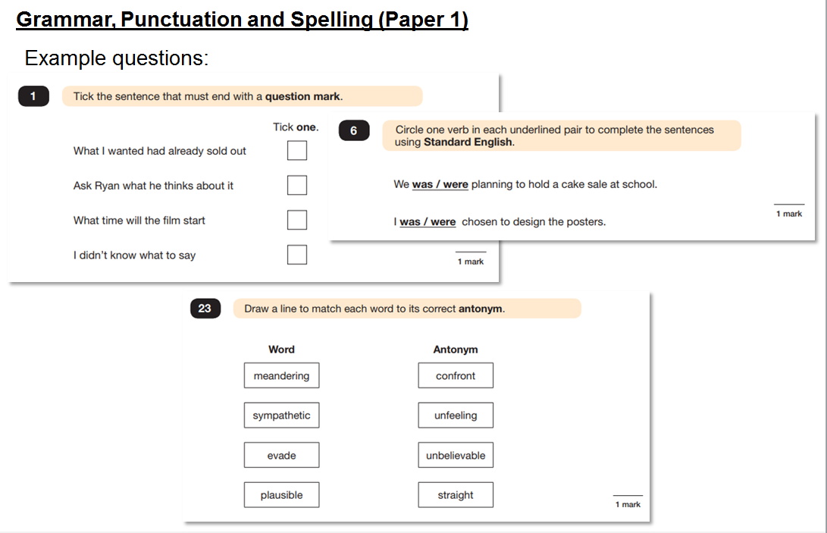

Slide 15
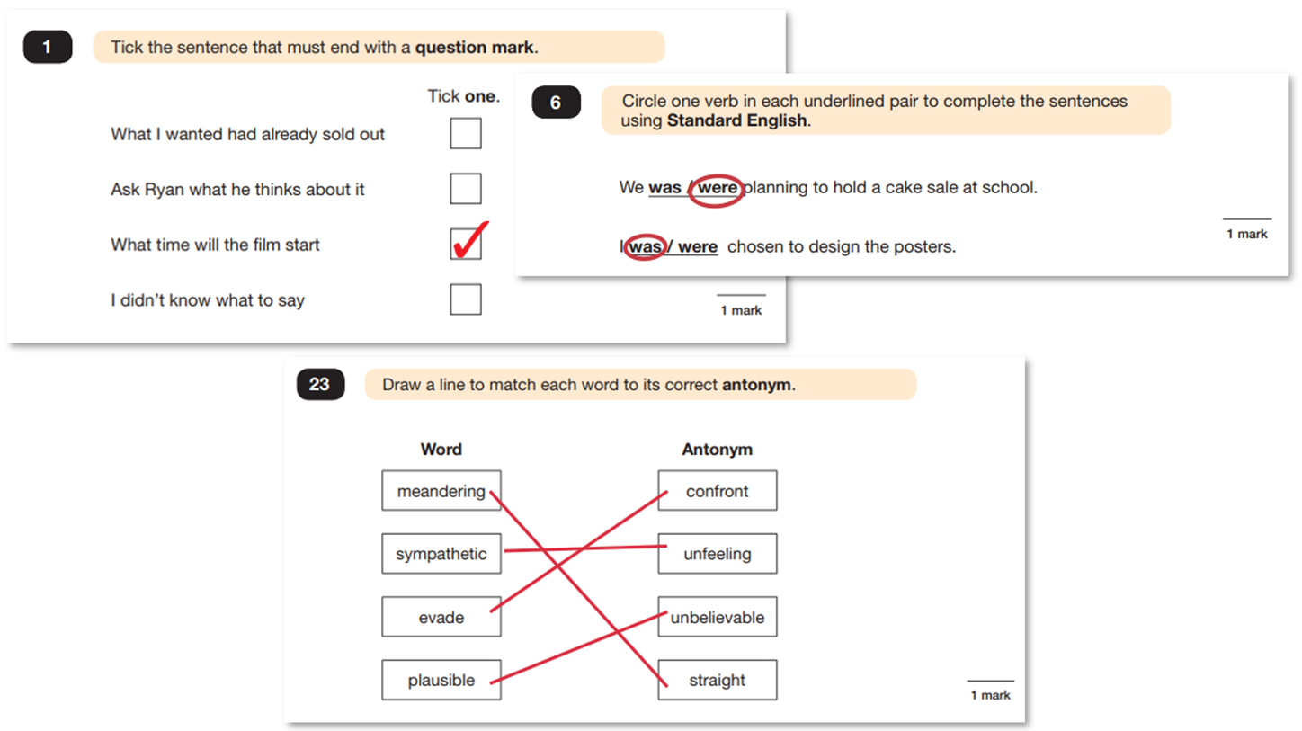

Slide 16
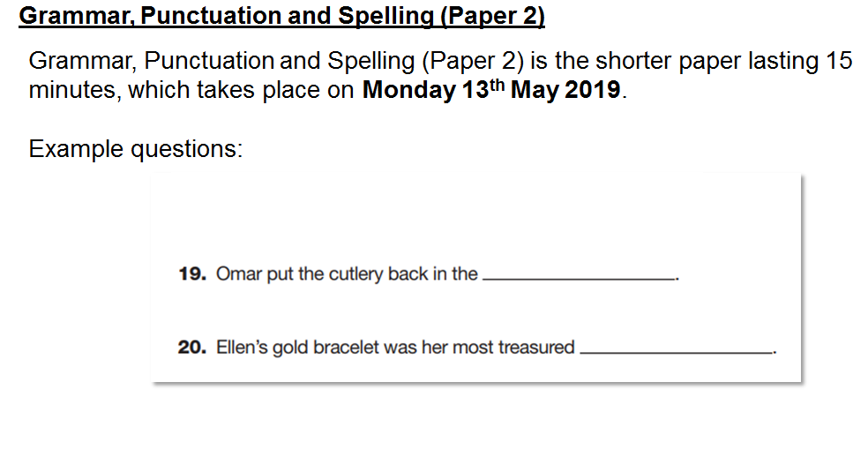

Slide 17
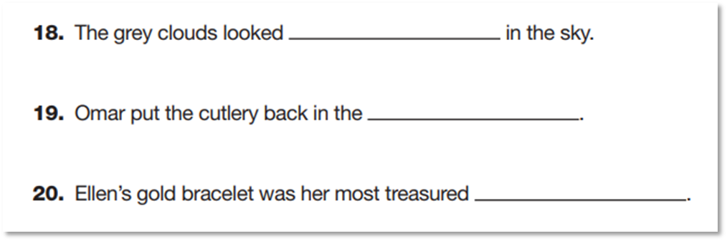
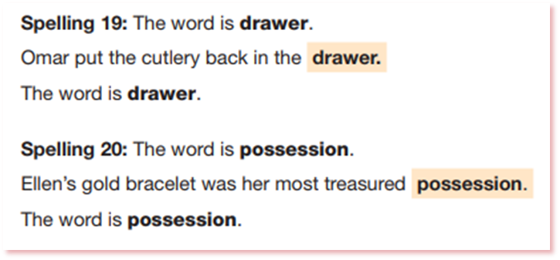

Slide 18
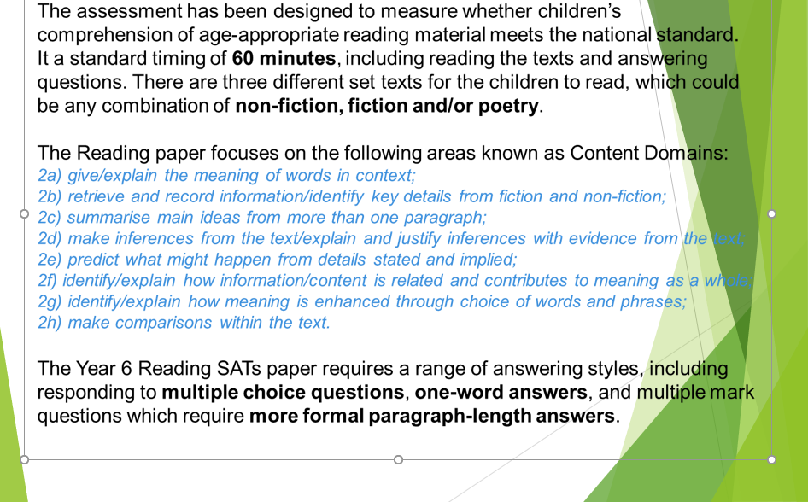
READING – 11th May 2020

Slide 19

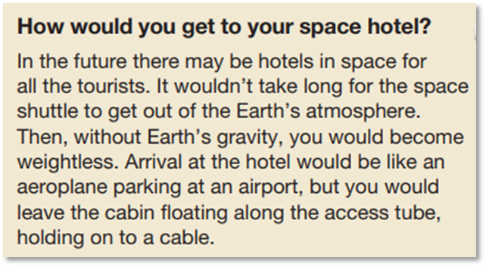
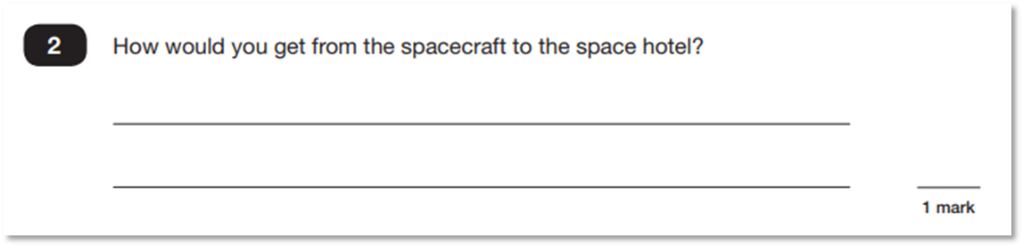

Slide 20
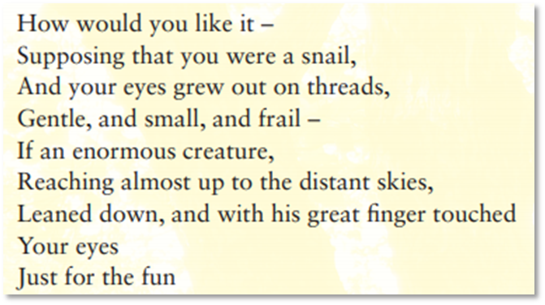

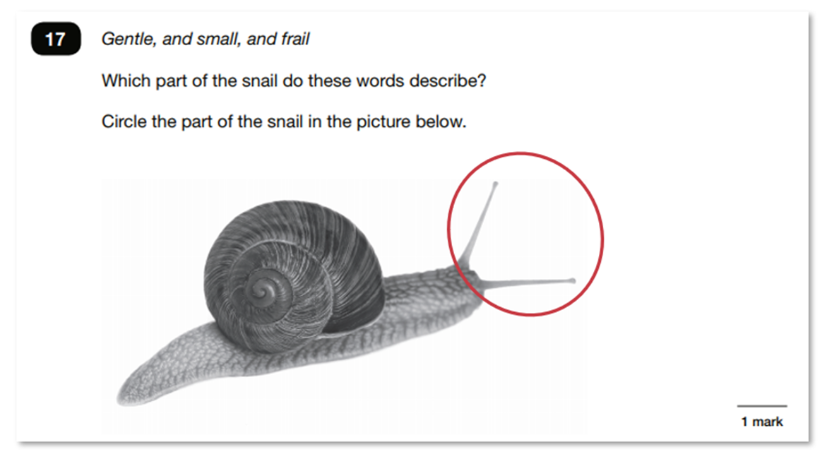

Slide 21

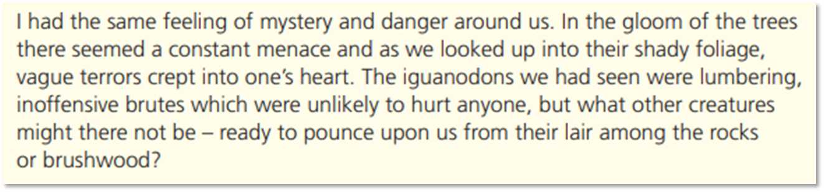
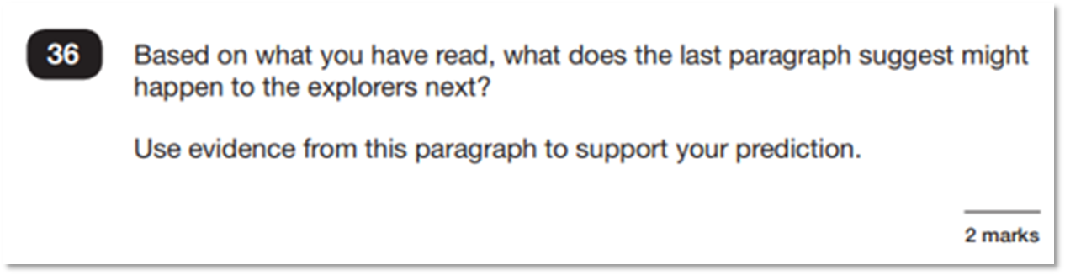
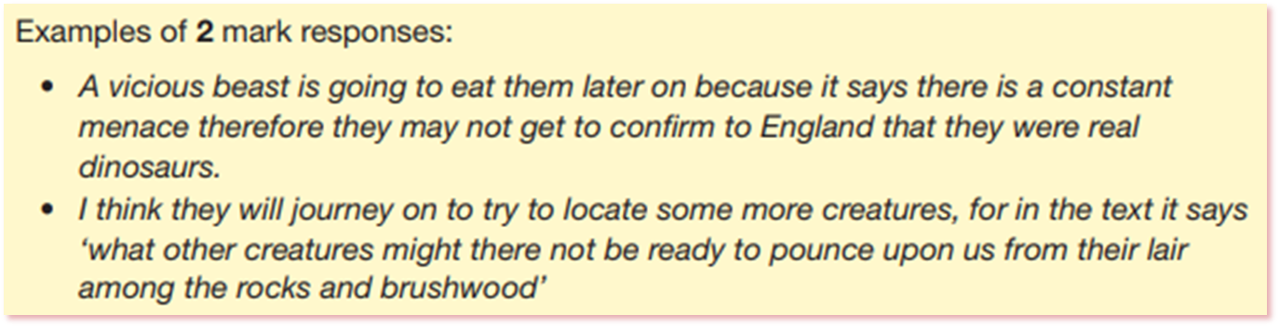

Slide 22
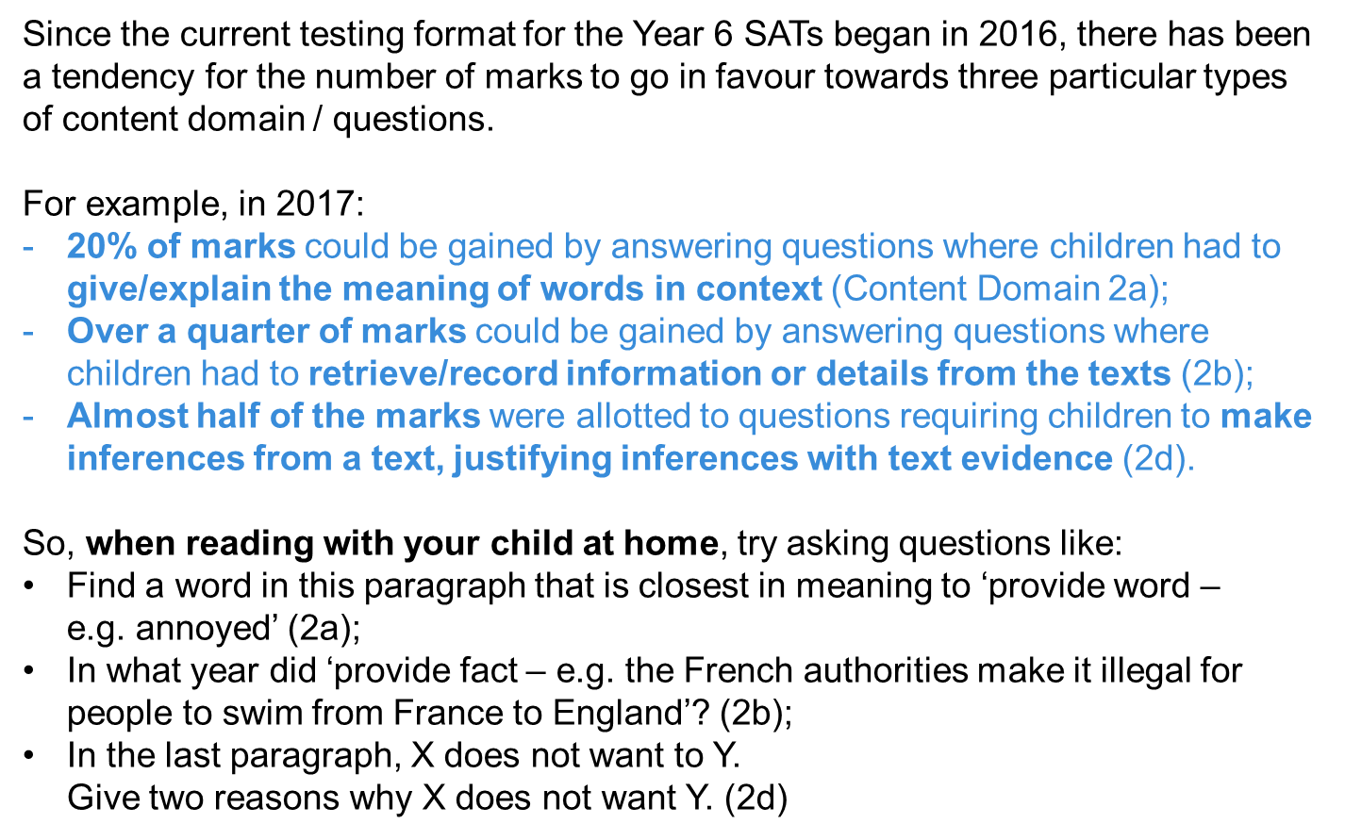

Slide 23
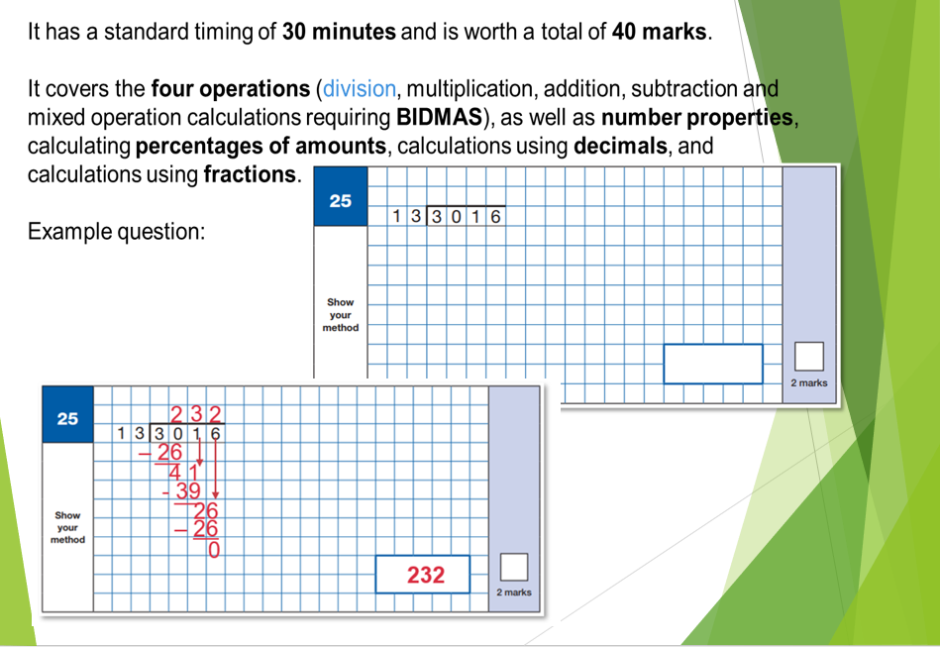
Maths Paper 1- 13th May 2020

Slide 24
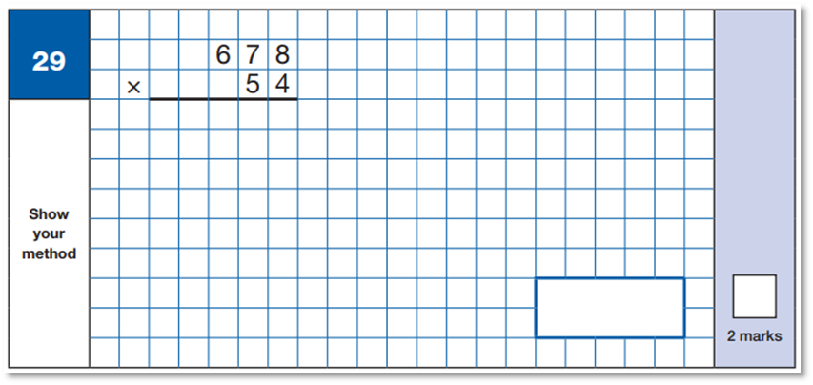
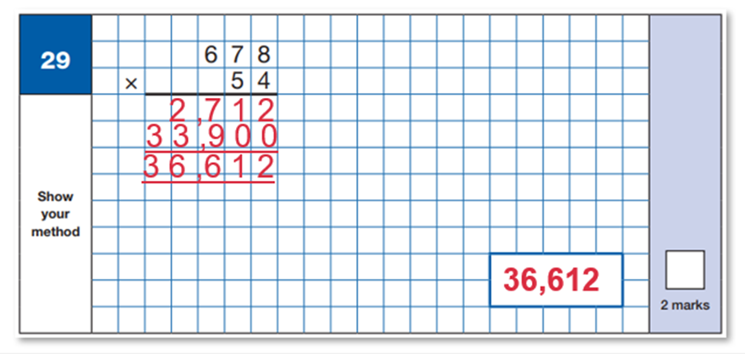

Slide 25
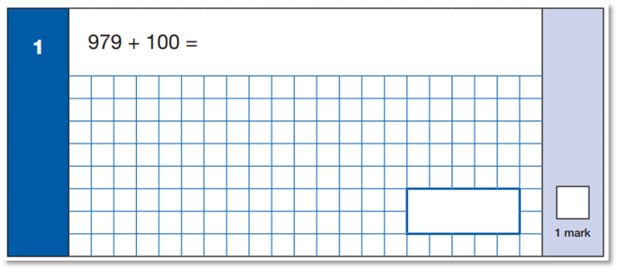
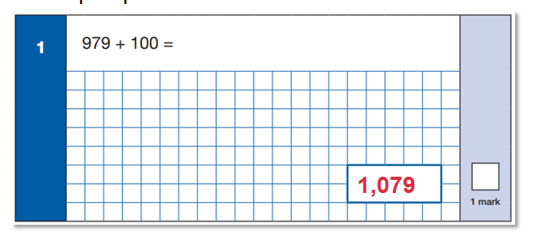

Slide 26
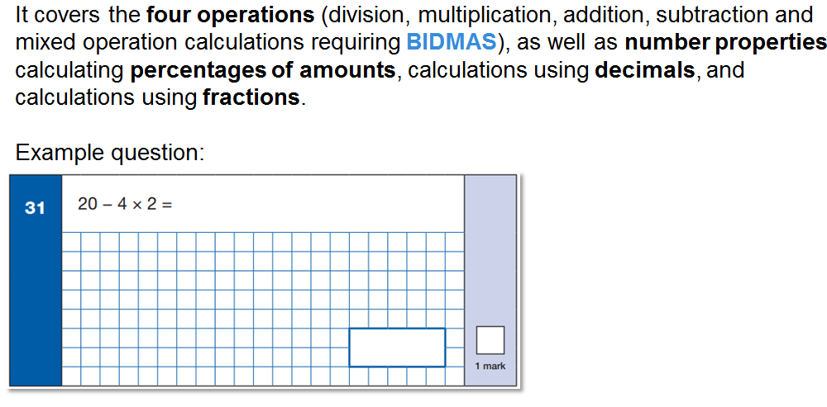
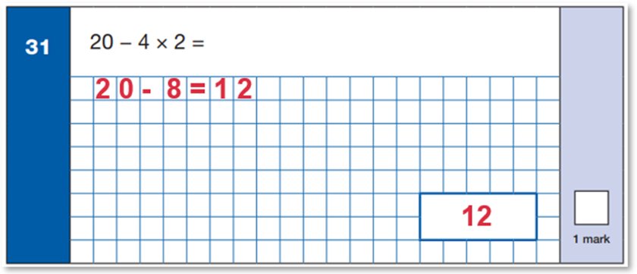

Slide 27
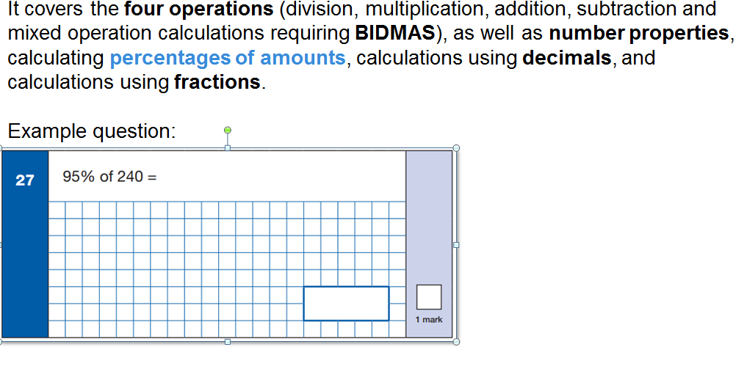
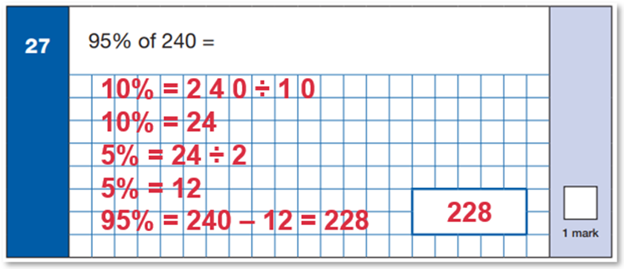

Slide 28
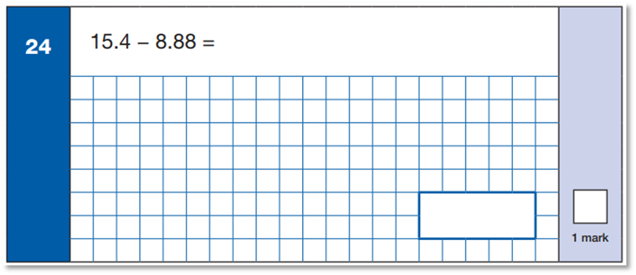
Decimals
6.52

Slide 29
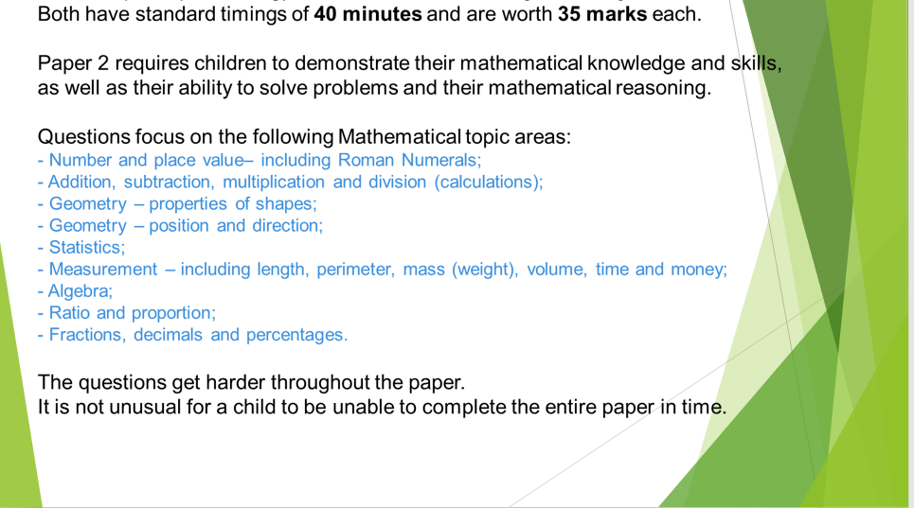
Maths paper 2&3- 14-15th May

Slide 30
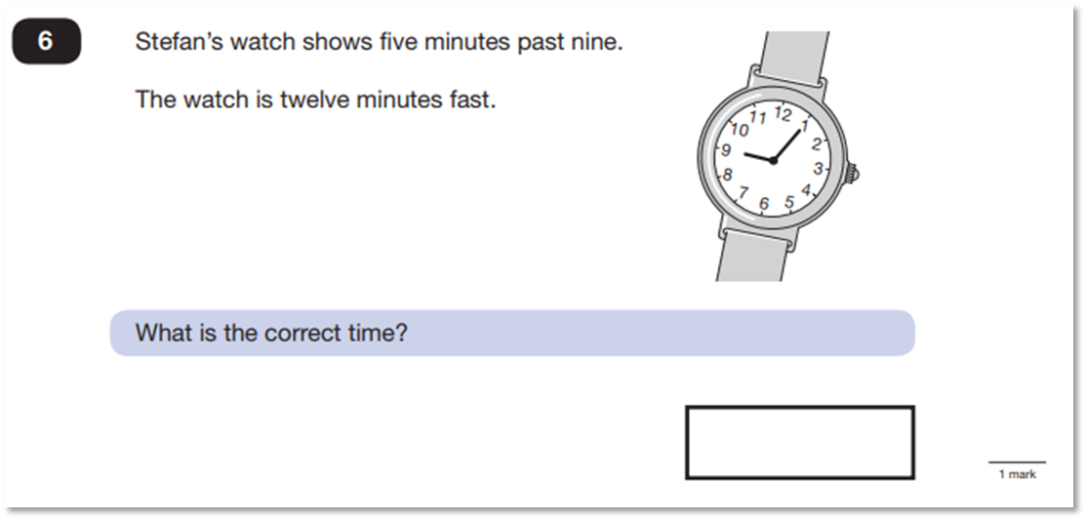

Maths Paper 2&3 (Reasoning)
Both have standard timings of 40 minutes and are worth 35 marks each.
8:53

Slide 31
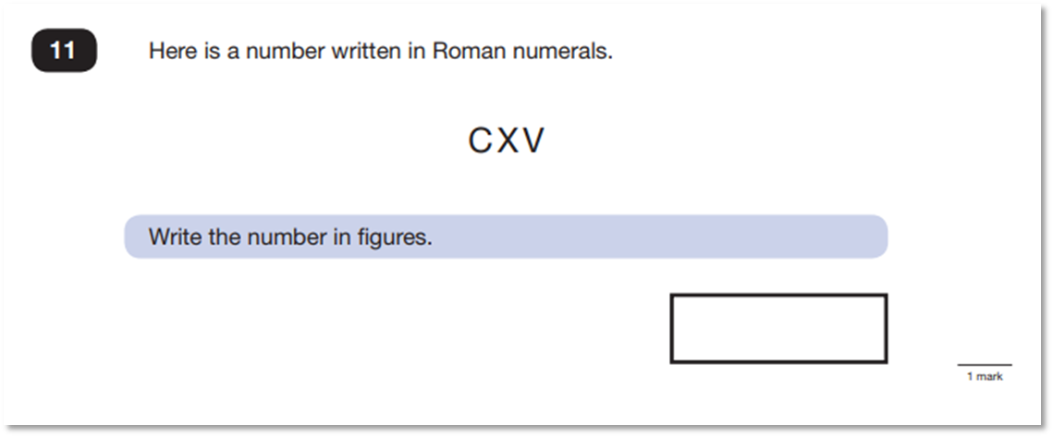


Slide 32
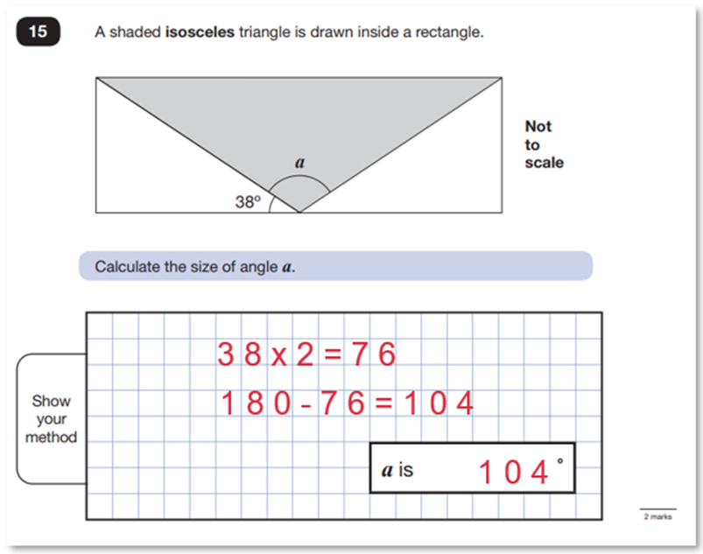

Slide 33
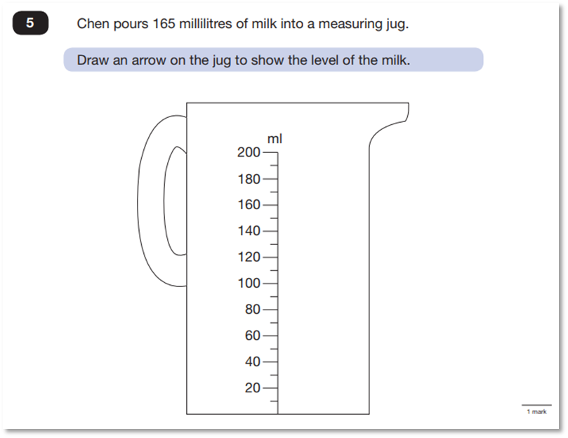

Slide 34
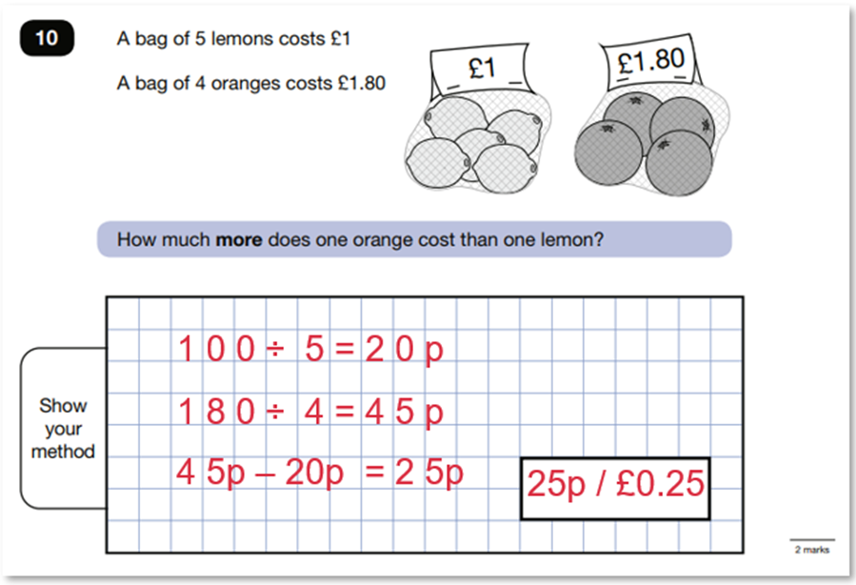

Slide 35
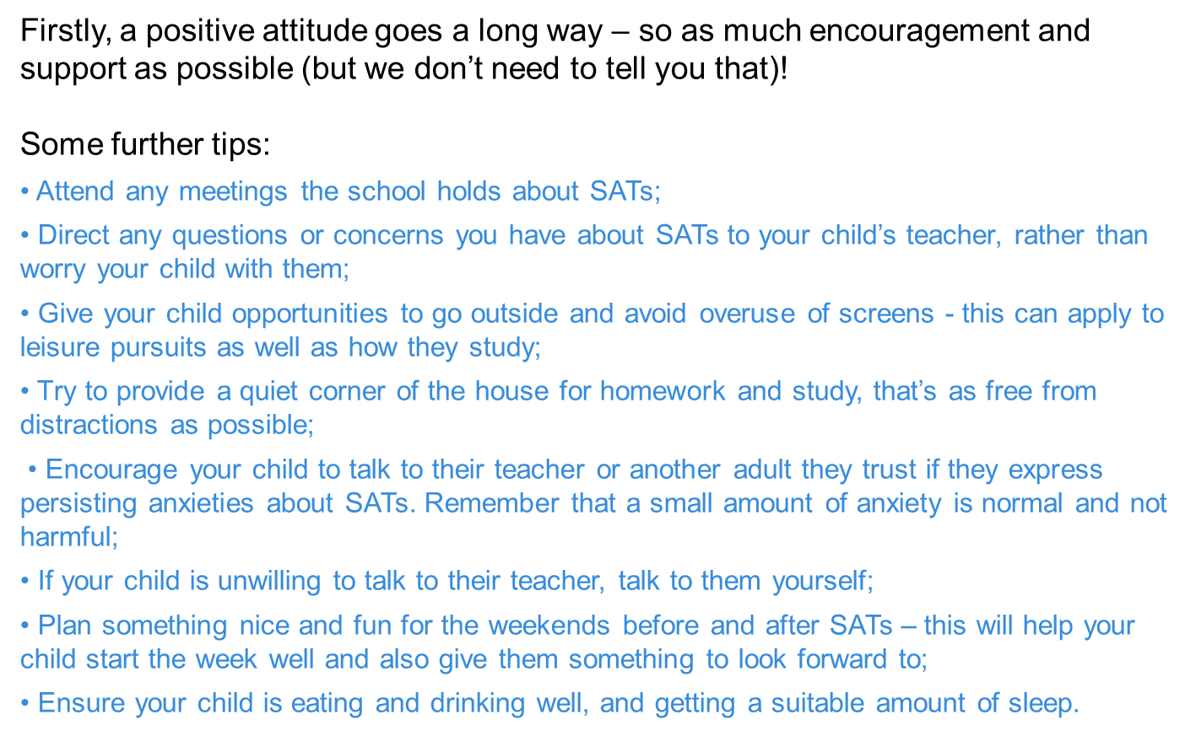
How can I support my child in preparing for their SATs?

Slide 36
Some further tips:
• Create a revision timetable that works for you and your child – for some children and families, a couple of 10 – 20 minute activities a day works best; for others, a longer study session on a Saturday or Sunday might be better.
• Avoid using past papers – there are plenty of inexpensive or free SATs practice materials for parents, including those shared by Third Space Learning’s sister-brand matr.org authored by experts at the Department for Education who write the real papers: (bit.ly/MatrY6SATsPack).
• Keep it light – practice key skills like times tables and practice mental maths in real world scenarios, like adding up prices in the shops, working out discount deals, and asking questions like, “If there are 1,300 grams of flour in this pack, what is that in kilograms?”

Slide 37
Remember this about SATs:
SATs focus on what they know about Maths and English
They won’t reflect how talented they are at Science, Geography, Art or PE, and they certainly won’t highlight positive personal characteristics such as kindness and integrity.
SATs results don’t always tell the whole story
The results will say they DID or DIDN’T meet a certain standard, but not necessarily by what margin. Additionally, the thresholds tend to change each year according to overall national performance, so what was classed as ‘did meet the expected standard’ in 2016 may have been considered a ‘did not’ in 2015.
SATs last for one week
In reality it’s just one or two papers lasting 30-60 minutes each day. You can’t emphasise enough the importance of keeping that in perspective.

Slide 38
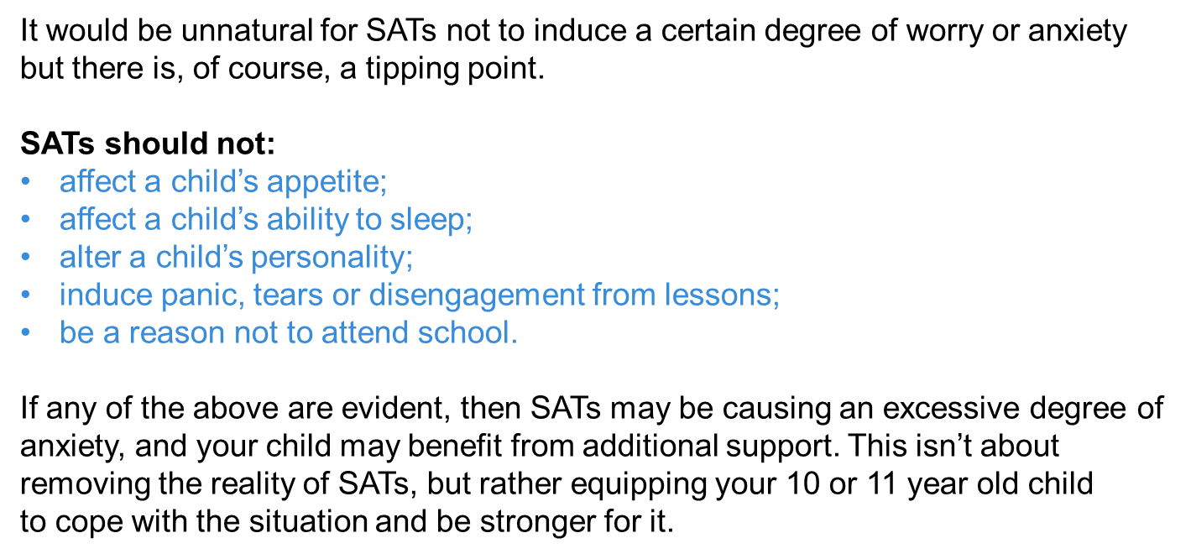
What should I do if I’m worried about my child?

Slide 39
Questions
Thank you for your attendance
this morning; we look forward to working with you to help your child achieve.
Hare Krishna

