Slide 1
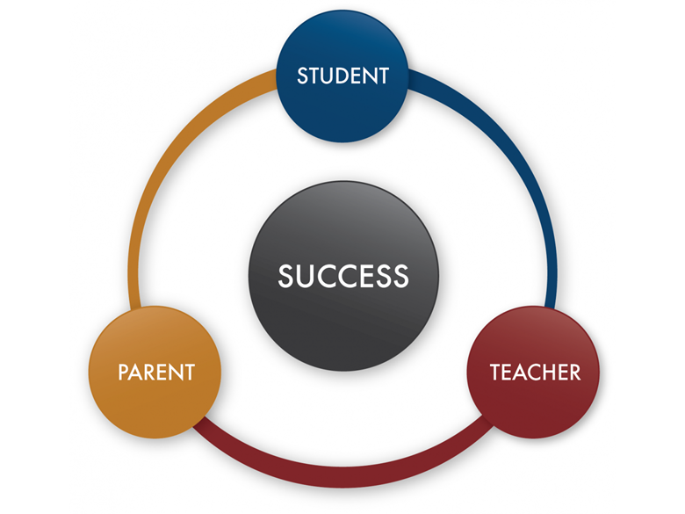
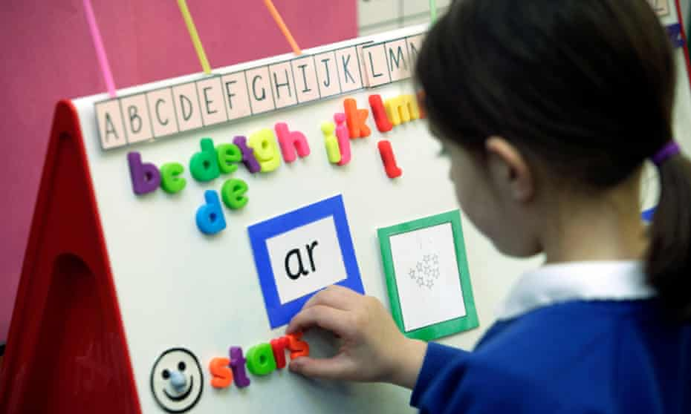
Year 1 Phonics Screening Check Workshop
Mrs. Nandha & Mr. Hirani
(Year 1 Class Teachers)
Thursday 24th April 2025

Slide 2
What is Phonics?
It is a method of reading and writing words by listening and identifying the sounds in the words.
It involves a range of blending and segmenting to support reading and writing.
There are 44 basic phonemes, represented by 26 letters and different combinations.

Slide 3
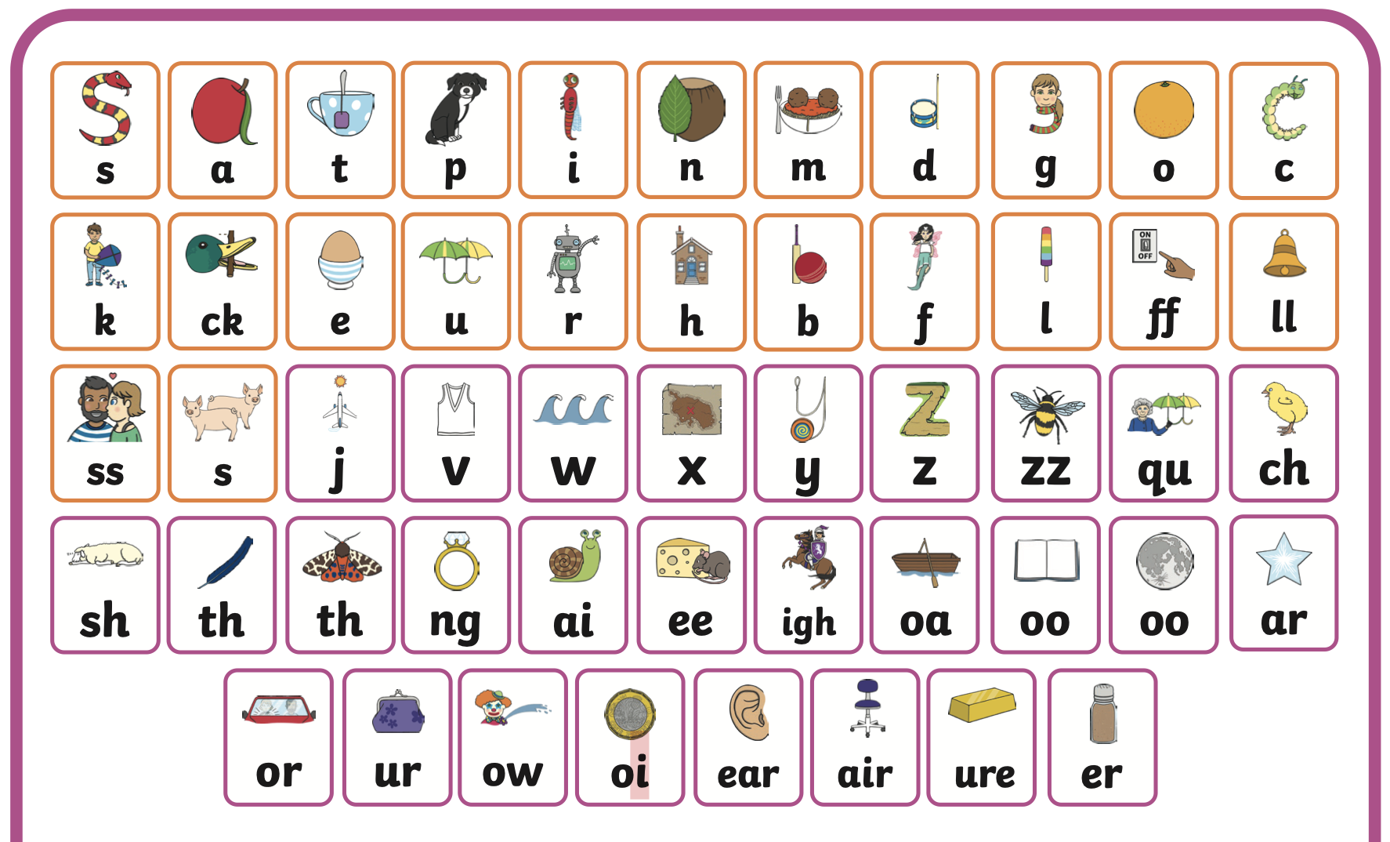
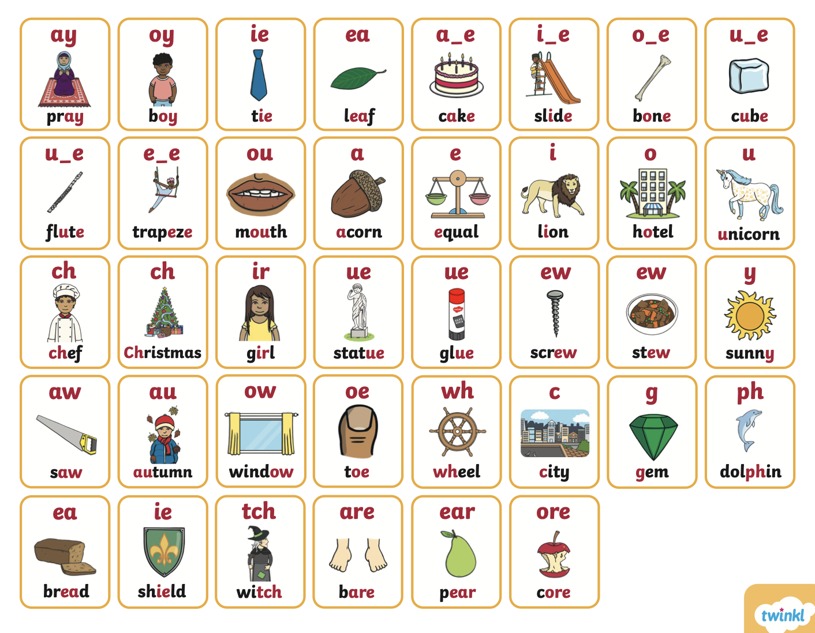
These are the sound mats we need to focus on – there are no Phase 4 clusters/blends anymore as this would be too much for the children to remember.
The children need to master the phonemes (sounds) that are shown here.

Slide 4
Level 5 Alternative Pronunciations
Taught in year 1, but not the focus for the Phonics Check
Focus on the phonemes on the previous slide as a priority – if your child is confident then move to these alternative pronunciations in general.

Slide 5
Phonic Terminology
TRIGRAPH
DIGRAPH
SPLIT DIGRAPH
ALTERNATIVE PRONOUNCIATION
CVC
PHONEME
GRAPHEME
COMMON EXCEPTION WORDS (TRICKY WORDS)
Notes:
-ask staff to describe definition of phonics
CVC= SHOP LIGHT
5

Slide 6
Phonic Terminology
Phoneme: smallest unit of sound that can be heard in a word
Grapheme: The letters used to represent the sound ( g / sh / th / ure )
Digraph: 2 letters that make 1 sound ( sh/ er / or )
Trigraph: 3 letters that make 1 sound ( igh / air )
Split Digraph: a digraph whose letters are not adjacent (next to each other)
( make / bike / flute )
CVC: consonant vowel consonant ( cat / pin / ten / van / sun )
CCVC/ CVCC/CCVCC: ( train / belt / crisp )
CEW/(Tricky Words): words that can not be decoded – Common Exception Words
Alternative Pronunciations: graphemes that have different sounds ( pin / find , cow / snow , chick / chef )
Notes:
Make a list of a range of cvc words (book/night/train)
6

Slide 7
How we teach at school
Intro Revisit Teach Practise Apply Assess
25 - 30 minutes
Consistent and daily
Interactive
Multisensory (robot arms, fingers, sound buttons)
Always applying through everyday activities

Slide 8
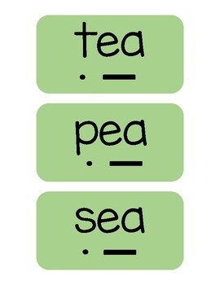
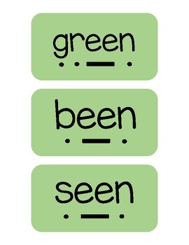
Sound Buttons
An excellent strategy helps you identify if your child is struggling with any sounds, and we do this all the time in school, so they are very familiar with the concept.

Slide 9
What Is The Phonics Screening Check?
Children in year 1 throughout the country will all be taking part in a Phonics Screening Check during the week commencing Monday 9th June 2025.
We are not allowed to tell you or the children which day they will complete the check due to DFE guidance so we will judge everything on a daily basis, based on our individual assessments of each child.
The Phonics Screening Check is designed to confirm whether individual children have learnt sufficient phonic decoding and blending skills to an appropriate standard (as set by the DfE / Government).

Slide 10
What Happens During The Check?
The check contains 40 words.
Each child will sit one to one and read each word aloud to a class teacher.
The test will take approximately 5-10 minutes per child, although all children are different and will complete the check at their own pace.
The list of words the children read is a combination of 20 real words and 20 pseudo words (also known as nonsense / alien words).
We don’t call it a check or test but say it is a phonics activity/game, that the children do on a regular basis in school - they are reading words during reading and phonics lessons at least weekly.

Slide 11
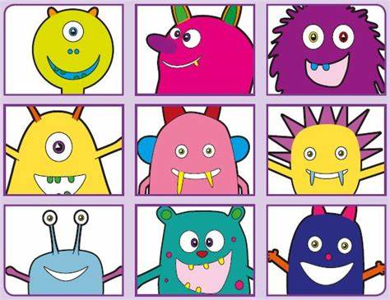

Slide 12
Pseudo Words (Alien/Nonsense Words)
The pseudo words will be shown to your child with a picture of an alien. This provides the children with a context for the pseudo word which is independent from any existing vocabulary they may have.
Pseudo words are included because they will be new to all pupils; they do not favour children with a good vocabulary knowledge or visual memory of words.
Please note that the child will NEVER be asked to SPELL these pseudo words – after the check, the focus is on reading real words and we will not focus on these pseudo words again (ever!)

Slide 13
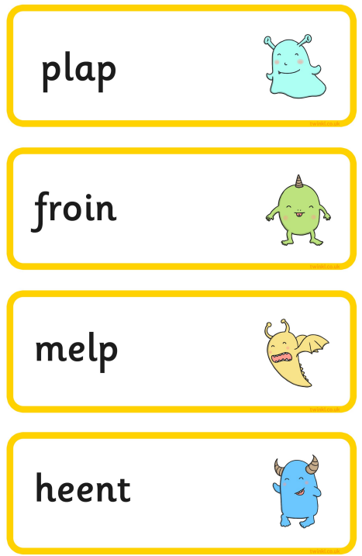
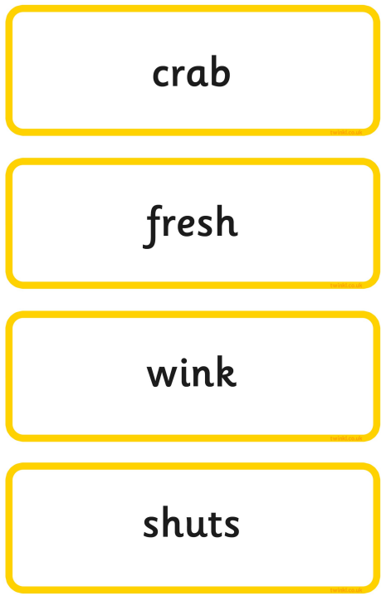
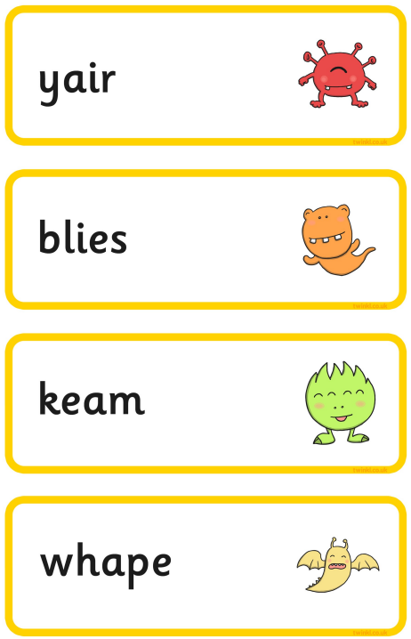
Example Of The Check

Slide 14
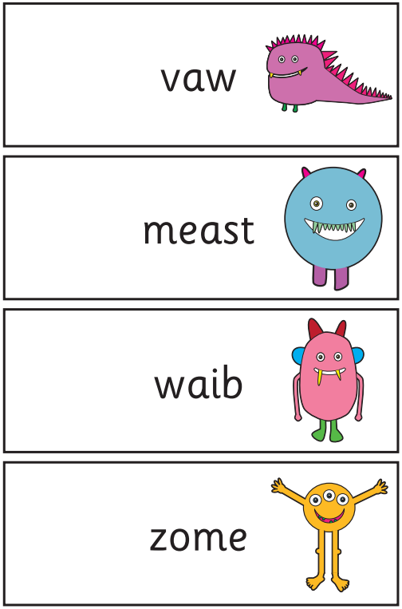
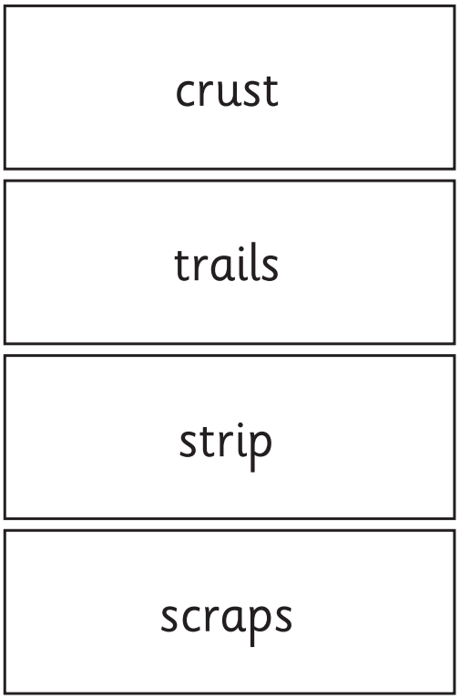
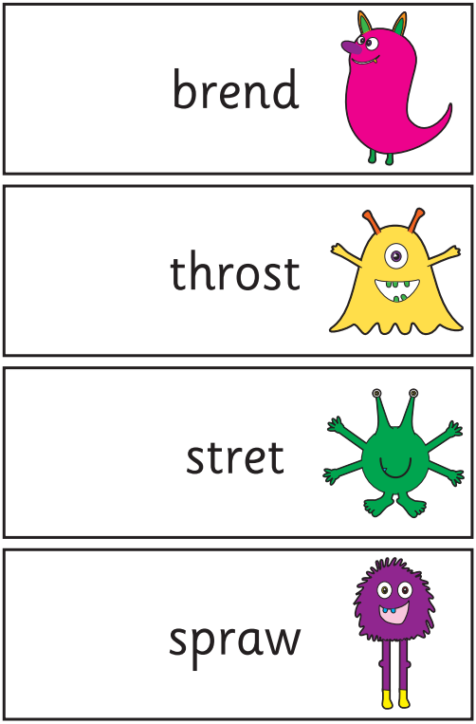
Example Of The Check 2019

Slide 15
Reporting To Parents
We will send the results with your child’s end of term report, at the end of the Summer term.
They will confirm if the child has met the standard threshold, as the DfE (Department for Education) set the pass mark and we don’t know until we receive the information from the DfE.
Children who do not achieve the expected level will retake the check when they are in year 2 and get further support to help them with their phonics learning.

Slide 16
How Can I Help My Child At Home?
Read as much as possible to and with your child.
Encourage and praise – get them to have a ‘good guess’ at real words.
If your child is struggling to decode a word, help them by encouraging them to say each sound in the word from left to right.
Blend the sounds by pointing to each letter, e.g. /c/ in cat, or the letter group, e.g. /ng/ in sing - next move your finger under the whole word as you say it.
Discuss the meaning of real words if your child does not know what they have read.

Slide 17
How Can I Help My Child At Home?
Have the sound mats at home (school has already provided)
Phoneme spotters (comprehensions/texts)
Highlighting sounds
Sound buttons
Rhyming words
Interactive games like www.phonicsplay.co.uk
Explore a bank of words with alternate sounds/ spellings and build a discussion of how some sounds are rare and some more common

Slide 18
Resources for You
http://avanti.org.uk/avantihouse-primary/phonics
The above link has all the information you will need to support you in revision for phonics daily and for the check. It also has past checks for you to use as well.
https://youtu.be/fOwfFX8wESk?si=zfKaI0MXNomKWCmR
https://youtu.be/Y28ipm_v_q8?si=AlY67iREM1sPE04h

Slide 19
Resources for You – Video Links for Correct Pronunciations (Important)
Level 2 sounds: https://www.youtube.com/watch?v=g7R3J8Z1h2M&list=PLmLqUswhmbsVGfdrxmelqmcgGd1b5rz8G&index=3
Level 3 sounds: https://www.youtube.com/watch?v=sVCpBfulHn4&list=PLmLqUswhmbsVGfdrxmelqmcgGd1b5rz8G&index=4
Level 5 sounds: https://www.youtube.com/watch?v=BNGPletzezE

Slide 20
Finally…
Thank you for attending.
We will send this presentation out by the end of the week on Tapestry, with some additional materials.
Any questions, please write them in your child’s diary.
HARE KRISHNA

