Slide 1
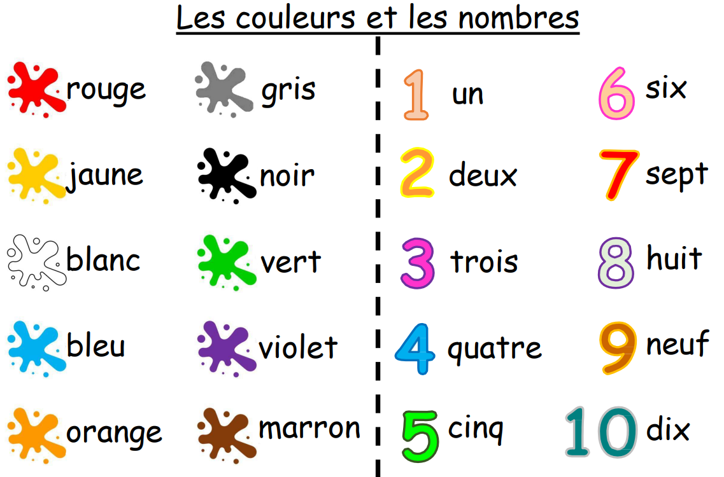
EYFS
In Reception, we have been learning lots of different songs and exploring colors.
Can you go on a French color and number hunt? 🎨🔢

Slide 2
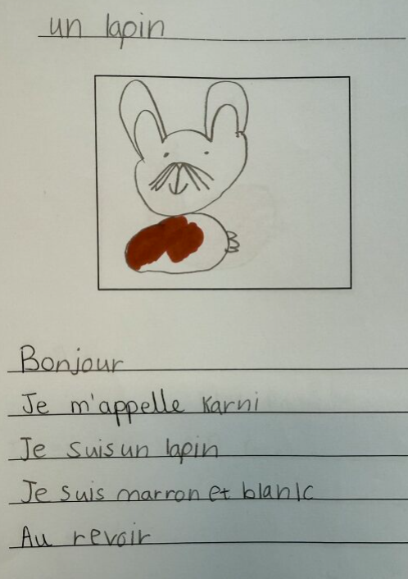
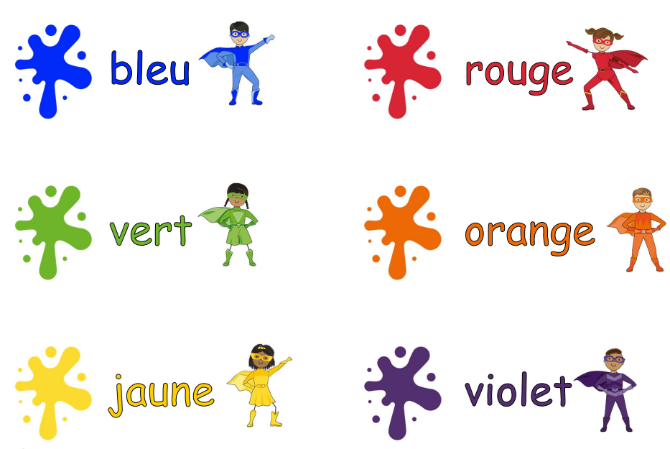
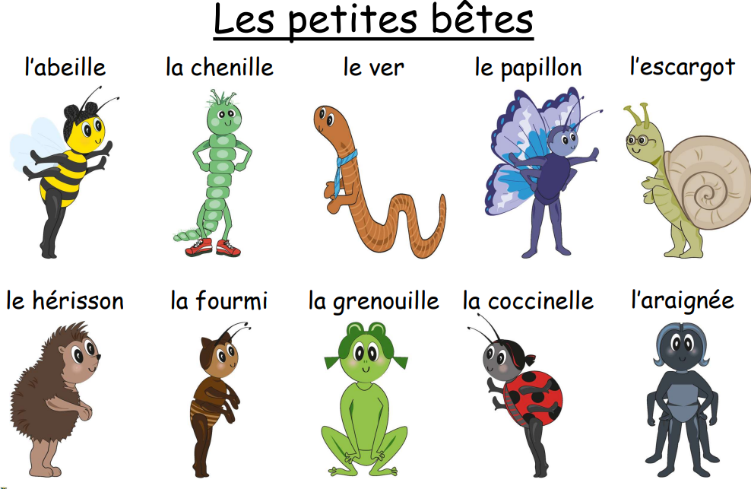
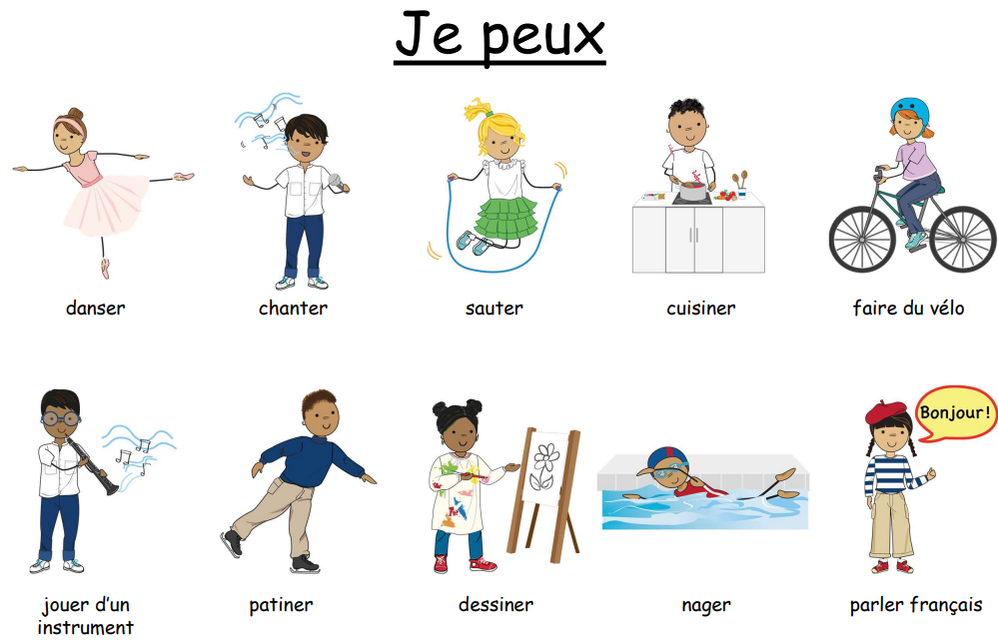
Year 1
We have learned vocabulary for colors, mini beasts, and how to say the phrase "I am..." (Je suis...).
Currently, we are learning how to say "I can..." (Je peux...) along with various verbs.

Slide 3
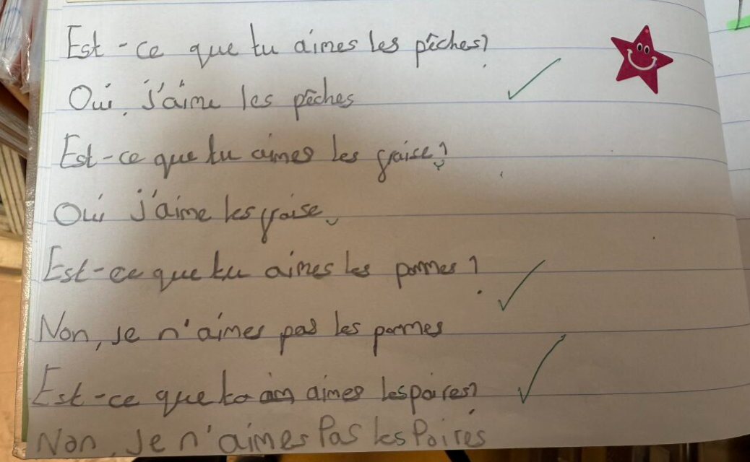
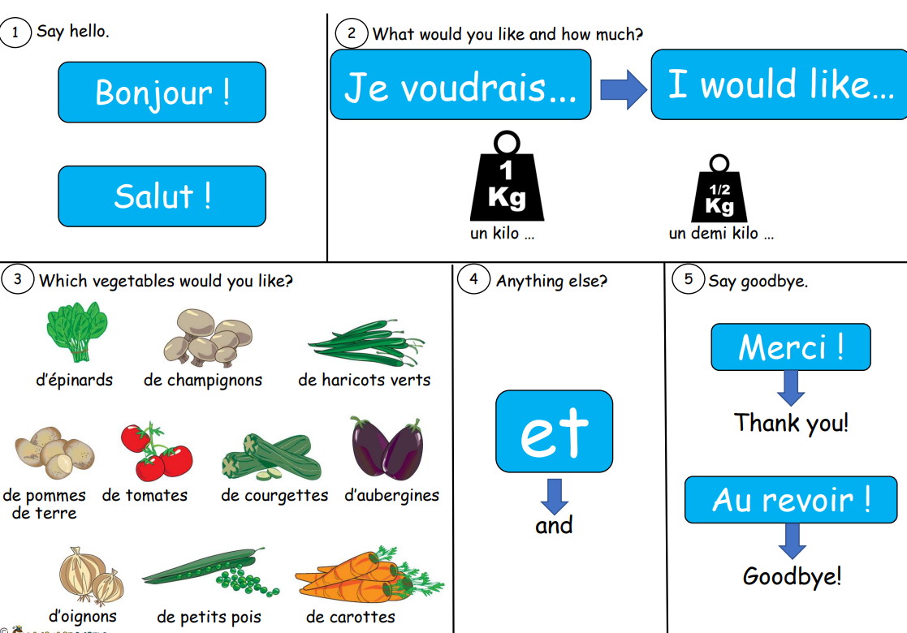
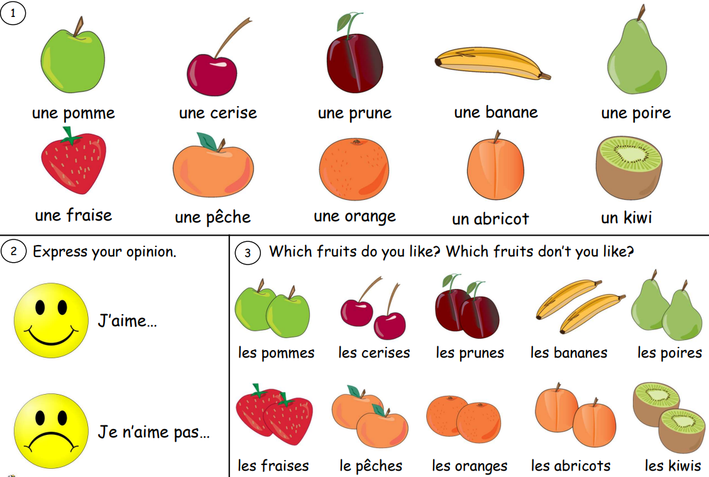
Year 2
This year, we have learned how to ask for quantities of vegetables and express our likes and dislikes regarding fruits. Currently, we are learning how to say which musical instruments we play. Additionally, we have been practicing counting up to 20 and revisiting our colours.

Slide 4
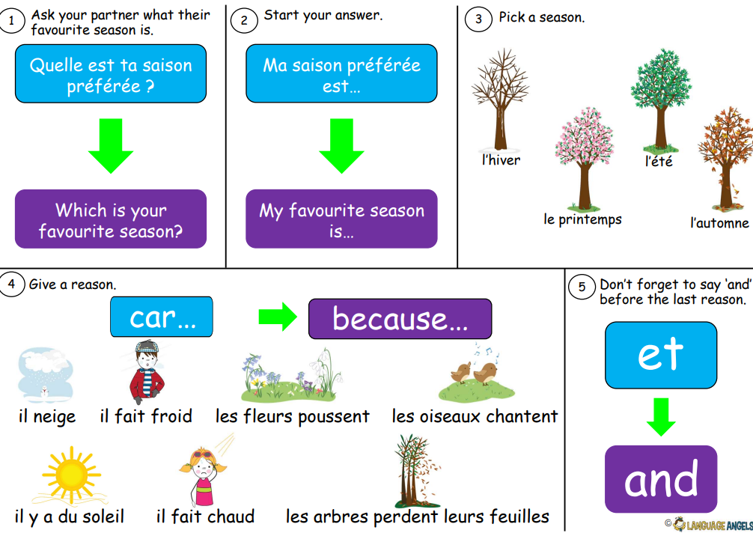
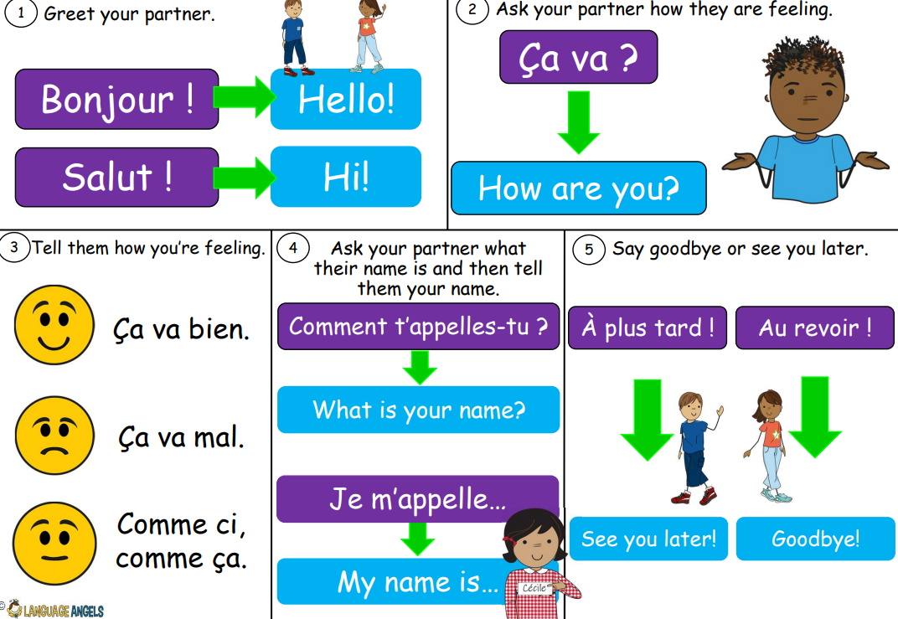
Year 3
We have learned to introduce ourselves and count up to 20. Currently, we are learning how to describe the different seasons.

Slide 5
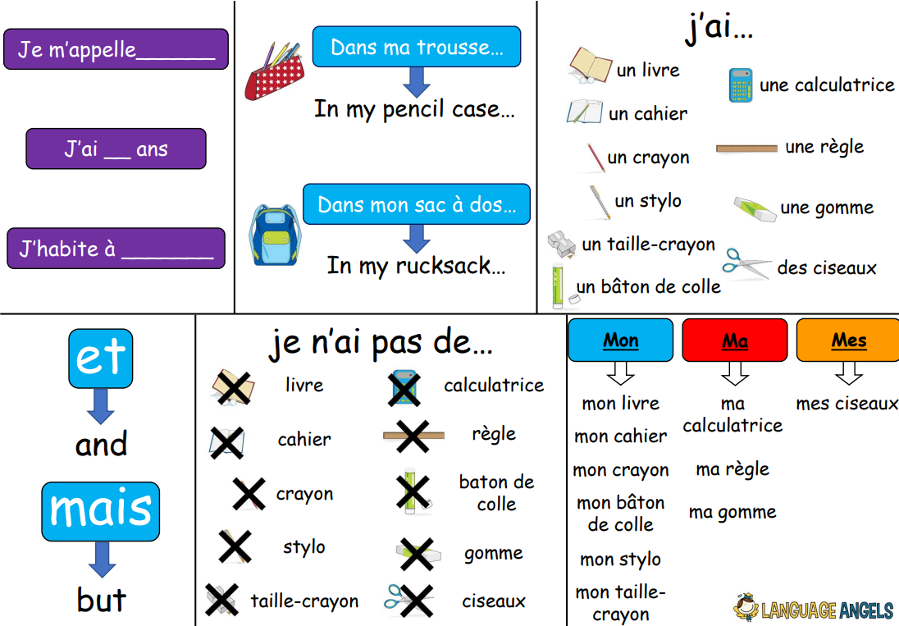
Year 4
We have been learning the names of classroom objects and how to confidently order food and drinks in a restaurant. We also had fun making our own menus!

Slide 6
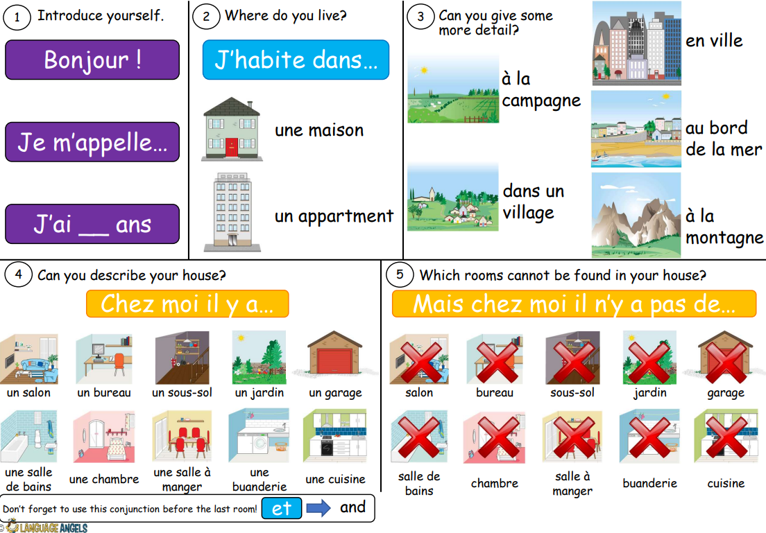
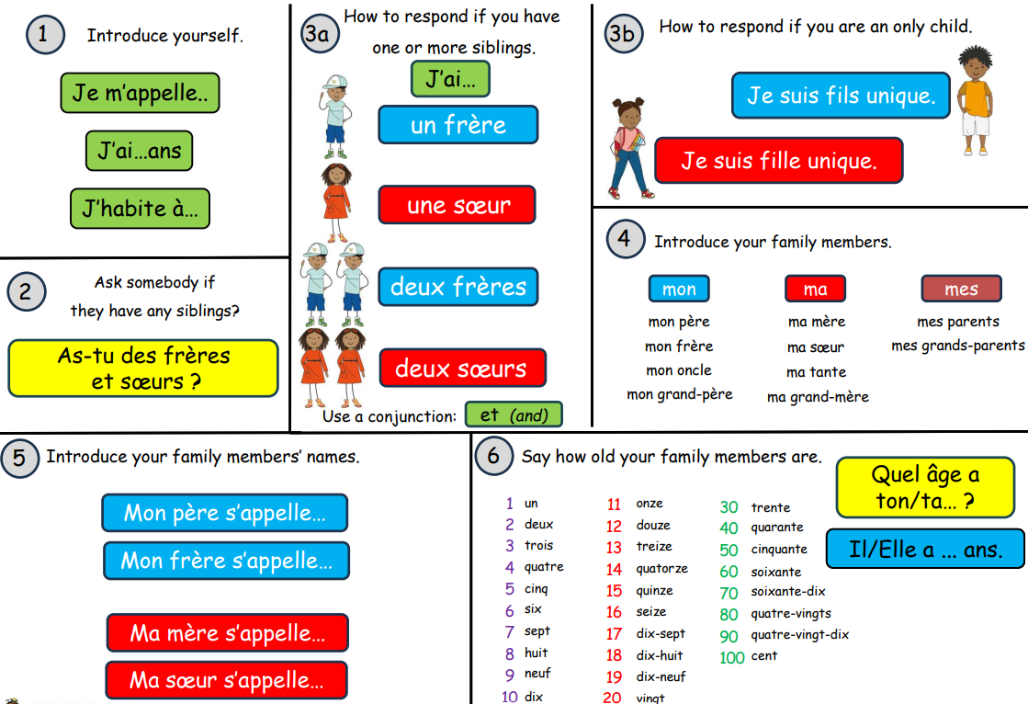
Year 5
We have been learning numbers up to 100 and how to describe where we live. We then created a PowerPoint presentation about our dream home. Currently, we are learning how to talk about our family.

Slide 7
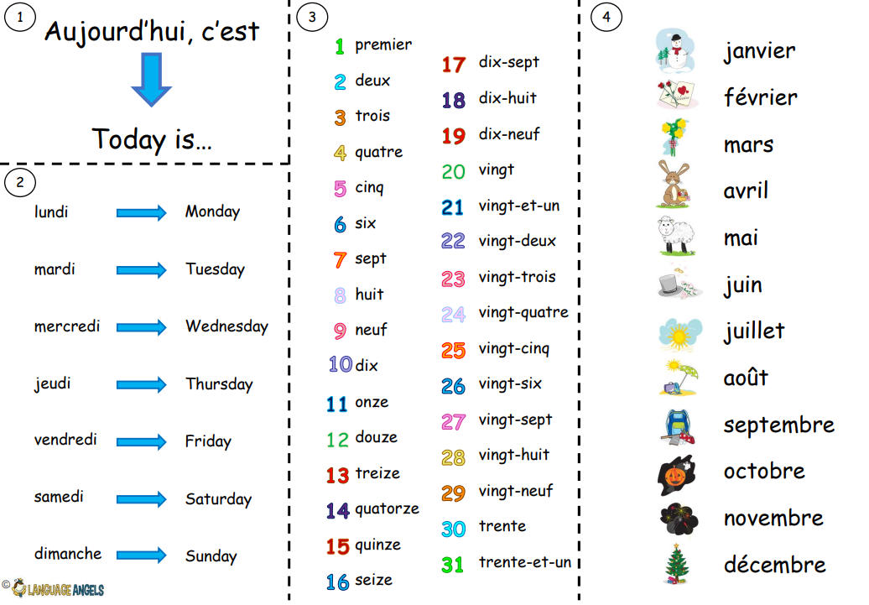
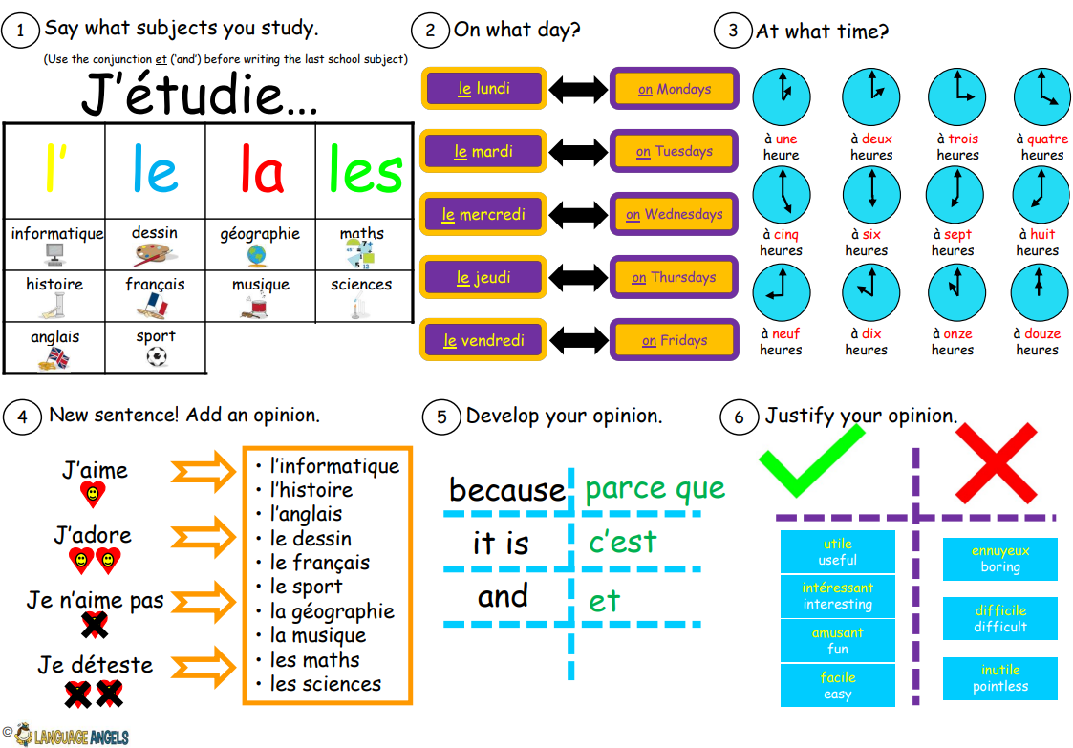
Year 6
We have been learning how to talk about dates and say when our birthday is. Currently, we are learning how to express which subjects we like and why. We are also writing letters to our pen pals at a school in France—and we can’t wait to hear back from them!

