Slide 1
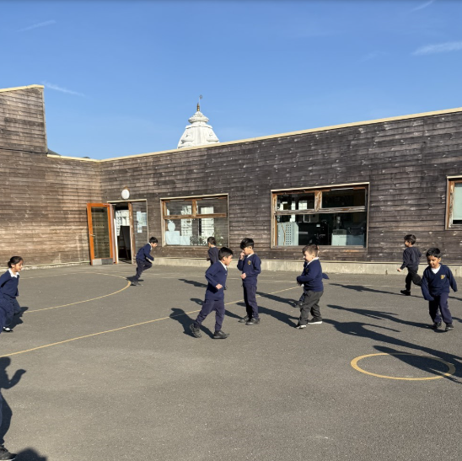
Reception played the traffic light game in French. For red (rouge) they stopped, Green (vert) they ran, yellow (jaune) they jumped, blue (bleu)they hopped.

Slide 2
Year 6 played ‘What’s the time Mr Wolf’ to practice telling the time.

Slide 3
Year 1 practiced the different verbs by doing the actions i.e. je peux nager ( I can swim)

Slide 4
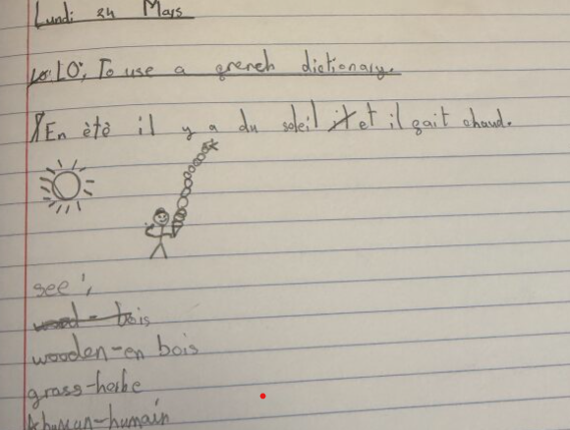
Year 3 went to explore what they could see and hear. They then used a dictionary to find the different adjectives in French

